Slide 1


Slide 2
Genetic Algorithm
Presenter’s NAME
Aiman Rashid (21-arid-539)
Parveen Kausar (21-arid-915)
Mehak Murtaza (21-arid-595)

Slide 3
Outline
Evolutionary Computing
What is G.A?
G.A Algorithm
G.A Operators
G.A Example
G.A Benefits
G.A Limitations
Why we use G.A
G.A Applications
G.A conclusion

Slide 4
Evolutionary Computation
Evolutionary Computation is the field of study devoted to the design, development, and analysis is problem solvers based on natural selection (simulated evolution).
Evolution has proven to be a powerful search process.
Evolutionary Computation has been successfully applied to a wide range of problems including:
Aircraft Design,
Routing in Communications Networks,
Tracking Wind shear,
Game Playing (Checkers [Fogel])

Slide 5
Robotics,
Air Traffic Control,
Design,
Network Security
Scheduling,
Machine Learning,
Pattern Recognition,
VLSI Circuit Layout,
Strike Force Allocation,
Function Optimization

Slide 6
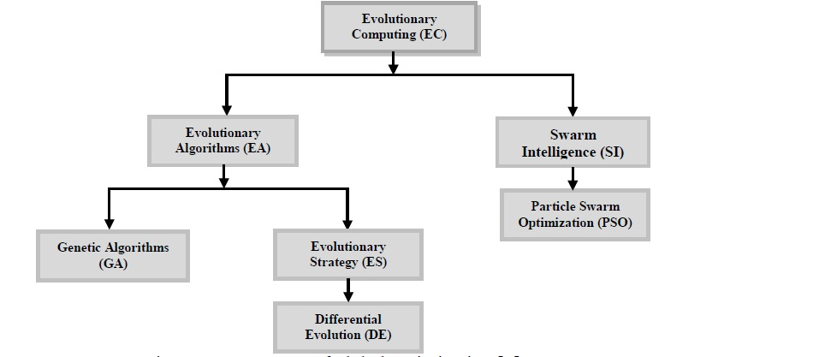
Evolutionary Computing algorithms
Evolutionary computing algorithms are very common and used by many researchers in their research to solve the optimization problems.

Slide 7
Genetic Algorithm

Slide 8
What is GA
Genetic algorithms are implemented as a computer simulation in which a population of abstract representations (called chromosomes or the genotype or the genome) of candidate solutions (called individuals, creatures, or phenotypes) to an optimization problem evolves toward better solutions.
Traditionally, solutions are represented in binary as strings of 0s and 1s, but other encodings are also possible.

Slide 9
Genetic Algorithms
A genetic algorithm conceptually follows steps inspired by the biological processes of evolution.
GA has been successfully applied to problems that are difficult to solve using conventional techniques such as scheduling problems, traveling salesperson problem, network routing problems and financial marketing.
Genetic Algorithms follow the idea of SURVIVAL OF THE FITTEST- Better and better solutions evolve from previous generations until a near optimal solution is obtained.

Slide 10
Genetic Algorithms
A genetic algorithm is an iterative procedure that represents its candidate solutions as strings of genes called chromosomes.
Genetic Algorithms are often used to improve the performance of other AI methods such as expert systems or neural networks.
The method learns by producing offspring that are better and better as measured by a fitness function, which is a measure of the objective to be obtained (maximum or minimum).

Slide 11
Algorithm
BEGIN
Generate initial population;
Compute fitness of each individual;
REPEAT /* New generation /*
FOR population_size / 2 DO
Select two parents from old generation;
/* biased to the fitter ones */
Recombine parents for two offspring;
Compute fitness of offspring;
Insert offspring in new generation
END FOR
UNTIL population has converged
END

Slide 12
Genetic learning algorithm
Step 1: Initialize a population P of n elements as a potential
solution.
Step 2: Until a specified termination condition is satisfied:
2a: Use a fitness function to evaluate each element of
the current solution. If an element passes the
fitness criteria, it remains in P.
2b: The population now contains m elements (m<= n).
Use genetic operators to create (n – m) new
elements. Add the new elements to the population.

Slide 13
Conceptual Algorithm
Initialize Population
Evaluate Fitness
Yes
satisfy constraints ?
No
Select Survivors
Randomly Vary Individuals
Output Results

Slide 14
Digitalized Genetic knowledge representation
A common technique for representing genetic knowledge is to transform elements into binary strings.
For example, we can represent income range as a string of two bits for assigning “00” to 20-30k, “01” to 30-40k, and “11” to 50-60k.

Slide 15
Key terms
Individual - Any possible solution
Population - Group of all individuals
Search Space - All possible solutions to the problem
Locus - The position of a gene on the chromosome
Genome - Collection of all chromosomes for an individual

Slide 16
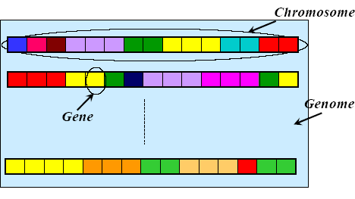
Chromosome, Genes and Genomes

Slide 17
Genetic Operator
“A genetic operator is a function that is used to create a
new individual in a population of individuals for a
genetic algorithm”
Types
Selection
Crossover
Mutation

Slide 18
Genetic operator - Selection
Selection is to replace to-be-deleted elements by copies of elements that pass the fitness test with high scores.
With selection, the overall fitness of the population is guaranteed to increase.

Slide 19
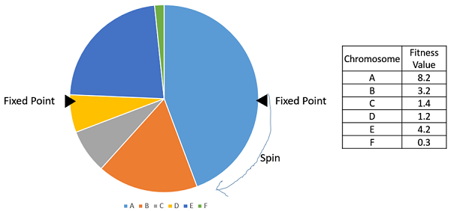

Slide 20
Genetic Operator - Crossover
The elements most often used for crossover are those intended to be eliminated from the population.
Crossover forms new elements for the population by combining parts of two elements currently in the population.

Slide 21
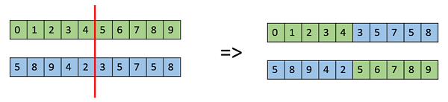

Slide 22
Genetic operator - Mutation
Mutation is carefully applied to elements chosen for elimination.
Mutation can be applied by randomly flipping bits (or attribute values) within a single element.

Slide 24
Genetic Algorithm Introduction
Inspired by natural evolution
Population of individuals
Individual is feasible solution to problem
Each individual is characterized by a Fitness function
Higher fitness is better solution
Based on their fitness, parents are selected to reproduce offspring for a new generation
Fitter individuals have more chance to reproduce
New generation has same size as old generation; old generation dies
Offspring has combination of properties of two parents
If well designed, population will converge to optimal solution

Slide 25



Initialize Population
Evaluate Fitness
Selection
Crossover
Mutation
YES
Output Results

Slide 26



1) Representation (encoding)
Possible individual’s encoding
Bit strings (0101 ... 1100)
Real numbers (43.2 -33.1 ... 0.0 89.2)
Permutations of element (E11 E3 E7 ... E1 E15)

Slide 27
2) Initialization
Start with a population of randomly generated individuals,
or
use A previously saved population
or
A set of solutions provided by a human expert
or
- A set of solutions provided by another heuristic algorithm

Slide 28
Example (selection2)
Suppose that, after performing selection, we get the following population:
s₁` = 1111010101 (s₁)
s₂` = 1110110101 (s₃)
s₃` = 1110111101 (s₅)
s₄` = 0111000101 (s₂)
s₅` = 0100010011 (s₄)
s₆` = 1110111101 (s₅)

Slide 29
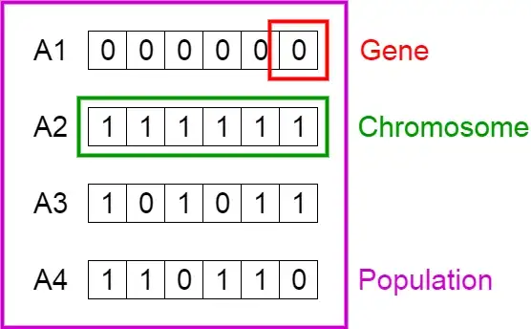

Slide 30
3) Evaluation (fitness function)
Solution is only as good as the evaluation function; choosing a good one is often the hardest part
Similar-encoded solutions should have a similar fitness

Slide 31
Example (initialization & fitness function)
We toss a fair coin 60 times and get the following initial population:
s₁ = 1111010101 f (s₁) = 7
s₂ = 0111000101 f (s₂) = 5
s₃ = 1110110101 f (s₃) = 7
s₄ = 0100010011 f (s₄) = 4
s₅ = 1110111101 f (s₅) = 8
s₆ = 0100110000 f (s₆) = 3
In first solution with name S1 , first four times head comes so we assign 1111 and then tail we assign 0,same ten times we make a chromosome of bit of strings

Slide 32
4 ) Selection
Purpose: to focus the search in promising regions of the space
Inspiration: Darwin’s “survival of the fittest”

Slide 33
Example (selection1)
Next we apply fitness proportionate selection with the roulette wheel method:
Individual i will have a
probability to be chosen
We repeat the extraction as many times as the number of individuals we need to have the same parent population size (6 in our case)
1
2
Area is Proportional to fitness value
n
3
4

Slide 34
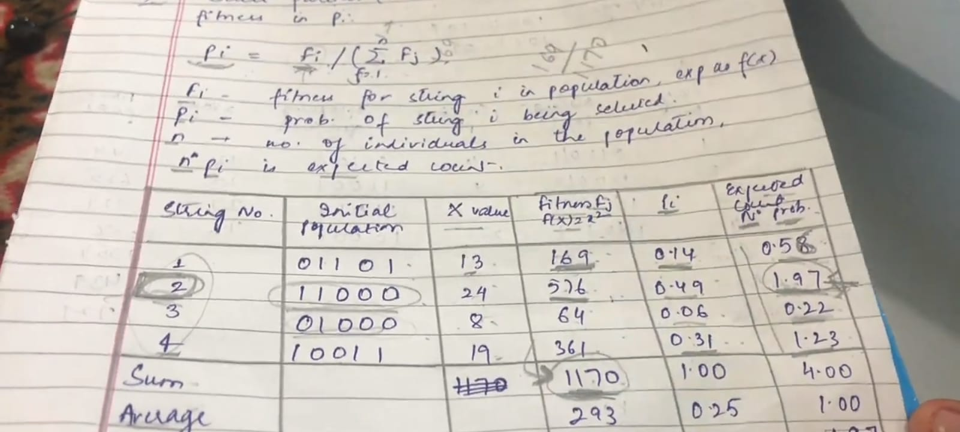
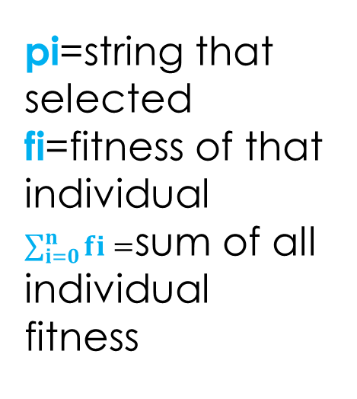
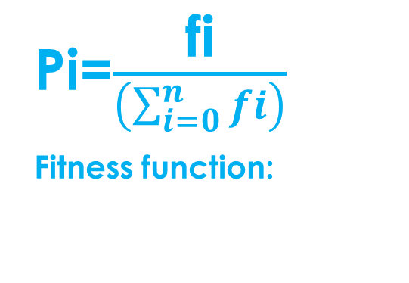
pi=string that selected fi=fitness of that individual $\sum_{i=0}^{n}{fi}=$sum of all individual fitness
Pi=$\frac{\text{fi}}{\left(\sum_{i=0}^{n}{fi}\right)}$
Fitness function:
F=(x^2)

Slide 35
5 ) Reproduction
Reproduction operators
Crossover
Mutation
Crossover
Two parents produce two offspring
Generally the chance of crossover is between 0.6 and 1.0
Mutation
There is a chance that a gene of a child is changed randomly
Generally the chance of mutation is low (e.g. 0.001)

Slide 36
Reproduction Operators
1) Crossover
Generating offspring from two selected parents
Single point crossover
Two point crossover (Multi point crossover)

Slide 37
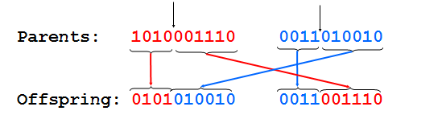
One-point crossover
Randomly one position in the chromosomes is chosen
Child 1 is head of chromosome of parent 1 with tail of chromosome of parent 2
Child 2 is head of 2 with tail of 1
Randomly chosen position

Slide 38
Example (crossover1)
Next we mate strings for crossover.
Suppose that we decide to actually perform crossover only for couples (s₁`, s₂`) and (s₅`, s₆`).
For each couple, we randomly extract a crossover point, for instance 2 for the first and 5 for the second

Slide 39
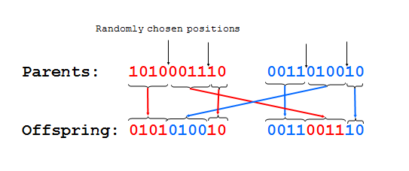
Two-point crossover
Randomly two positions in the chromosomes are chosen
Avoids that genes at the head and genes at the tail of a chromosome are always split when recombined

Slide 40
Example (crossover2)
Before crossover:
s₁` = 1111010101
s₂` = 1110110101
s₅` = 0100010011
s₆` = 1110111101
After crossover:
s₁`` = 1110110101
s₂`` = 1111010101
s₅`` = 0100011101
s₆`` = 1110110011

Slide 41
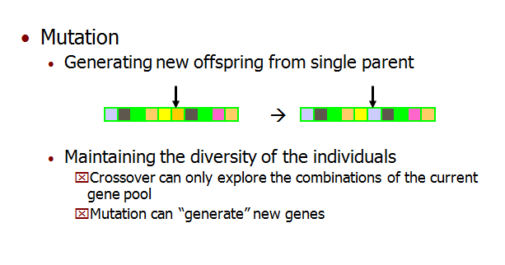
Reproduction Operators Mutation

Slide 42
Example (mutation1)
The final step is to apply random mutation: for each bit that we are to copy to the new population we allow a small probability of error (for instance 0.1)
Before applying mutation:
s₁`` = 1110110101
s₂`` = 1111010101
s₃`` = 1110111101
s₄`` = 0111000101
s₅`` = 0100011101
s₆`` = 1110110011

Slide 43
Example (mutation2)
After applying mutation:
s₁``` = 1110100101 f (s₁``` ) = 6
s₂``` = 1111110100 f (s₂``` ) = 7
s₃``` = 1110101111 f (s₃``` ) = 8
s₄``` = 0111000101 f (s₄``` ) = 5
s₅``` = 0100011101 f (s₅``` ) = 5
s₆``` = 1110110001 f (s₆``` ) = 6
Total number of 1’s after mutations are 37

Slide 44
6) Termination condition
A pre-determined number of generations or time has elapsed
A satisfactory solution has been achieved
No improvement in solution quality has taken place for a pre-determined number of generations

Slide 45
Example
In one generation, the total population fitness changed from 34 to 37, thus improved by ~9%
At this point, we go through the same process all over again, until a stopping criterion is met

Slide 46
Benefits of GAs
Concept is easy to understand
Supports multi-objective optimization
Always an answer; answer gets better with time
Notes:
Many ways to speed up and improve a GA-based application as knowledge about the problem domain is gained
Easy to exploit previous or alternate solutions
Flexible building blocks for hybrid applications
Substantial history and range of use

Slide 47
limitation of GAs
They can be difficult to debug.
Genetic algorithms are often criticized for being too slow
They are not effective in solving simple problems.
Lack of proper implementation may make the algorithm converge to a solution that is not optimal

Slide 48
Why we use Genetic Algorithms instead of traditional AI algorithm?/need of genetic algorithm
Provide optimization over large space state
Unlike traditional AI, they do not break on slight change in input or presence of noise

Slide 49
Application of GA
Genetic algorithms are applied in the following fields:
Transport: Genetic algorithms are used in the traveling salesman problem to develop transport plans that reduce the cost of travel and the time taken. They are also used to develop an efficient way of delivering products.
Image Processing − GAs are used for various digital image processing (DIP) tasks as well like dense pixel matching
Scheduling applications − GAs are used to solve various scheduling problems as well, particularly the time tabling problem.

Slide 50
conclusion
The genetic algorithm is a method for solving both constrained and unconstrained optimization problems that is based on natural selection, the process that drives biological evolution

Slide 51


